Slide 1

Park Mains
Christmas Countdown
Week Beginning
30th November 2020
Tuesday
1st December
Tree Ceremony
Christmas Toy
Bank Appeal
Christmas OAP Present Appeal
Wednesday 2nd December
Christmas Door Competition Launch

Slide 2
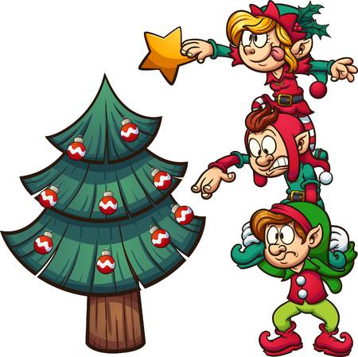

Park Mains
Christmas Countdown
Week Beginning
9 December
Monday 7 December
Christmas Crafts
Launch Reverse Advent Calendar
Wednesday 9 December
PMHS in the Community:
Presents delivered to
Care Homes

Slide 3


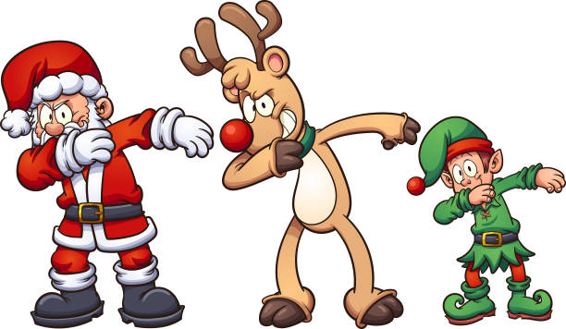
Park Mains
Christmas Countdown
Week Beginning
14 December
Monday 14 December
Christmas Assembly Week
Tuesday 15 December
Classrooms to Carehomes
Contactless Delivery
Pupil Christmas Lunch
Thursday 17 December
Whole School Quiz
House Winners

Slide 4

Park Mains
Christmas Countdown
Final Day of Term
Friday 18 December
S1/S2 Christmas Celebration
(periods 1 & 2)
Virtual Talent
Show
(periods 3 & 4)
Staff Virtual
Christmas
Thank You
Christmas Jumper Day – Staff and Pupils (Donations for Charity)

